Slide 1
Cell signalling
GPCR and role of second messenger (cAMP)
Janmoni Borah
Barnagar College
Sorbhog, Barpeta

Slide 2
Introduction..
cell signaling or cell communication is the ability of a cell to receive, process, and transmit signals with its environment and with itself.
Cell signaling is a fundamental property of all cellular life in prokaryotes and eukaryotes.
Signals that originate from outside a cell (or extracellular signals) can be physical agents like mechanical pressure, voltage, temperature, light, or chemical signals (e.g., small molecules, peptides or gas).
Chemical signals can be hydrophobic or hydrophilic. Cell signaling can occur over short or long distances, and as a result can be classified as autocrine, juxtacrine, intracrine, paracrine, or endocrine.
Signaling molecules can be synthesized from various biosynthetic pathways and released through passive or active transport, or even from cell damage.

Slide 3
Receptors play a key role in cell signaling as they are able to detect chemical signals or physical stimuli.
Receptors are generally proteins located on the cell surface or within the interior of the cell such as the cytoplasm, organelles, and nucleus.
Cell surface receptors usually bind with extracellular signals (or ligands), which causes a conformational change in the receptor that leads it to initiate enzymatic activity, or to open or close ion channel activity.
Some receptors do not contain enzymatic or channel-like domains but are instead linked to enzymes or transporters. Other receptors like nuclear receptors have a different mechanism such as changing their DNA binding properties and cellular localization to the nucleus.

Slide 4
Signal transduction begins with the transformation (or transduction) of a signal into a chemical one, which can directly activate an ion channel (ligand-gated ion channel) or initiate a second messenger system cascade that propagates the signal through the cell.
Second messenger systems can amplify a signal, in which activation of a few receptors results in multiple secondary messengers being activated, thereby amplifying the initial signal (the first messenger).
The downstream effects of these signaling pathways may include additional enzymatic activities such as proteolytic cleavage, phosphorylation, methylation, and ubiquitinylation.

Slide 5
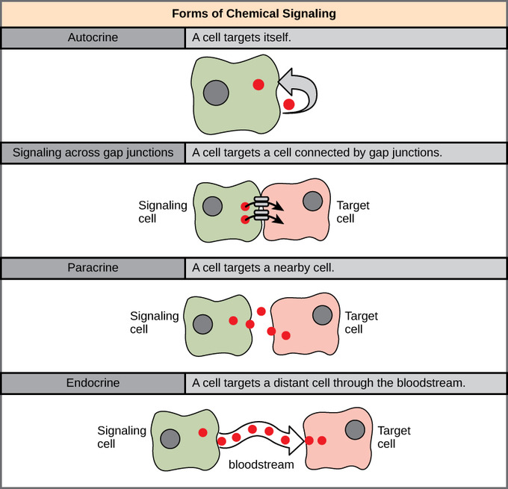

Slide 6
GPCR G protein coupled receptor
G protein-coupled receptor (GPCR), also called seven-transmembrane receptor or heptahelical receptor, protein located in the cell membrane that binds extracellular substances and transmits signals from these substances to an intracellular molecule called a G protein (guanine nucleotide-binding protein).
GPCRs are found in the cell membranes of a wide range of organisms, including mammals, plants, microorganisms, and invertebrates. T
here are numerous different types of GPCRs—some 1,000 types are encoded by the human genome alone
As a group they respond to a diverse range of substances, including light, hormones, amines, neurotransmitters, and lipids.

Slide 7
Second messenger and cAMP
Second messengers are intracellular signaling molecules released by the cell in response to exposure to extracellular signaling molecules—the first messengers.
Second messengers trigger physiological changes at cellular level such as proliferation, differentiation, migration, survival, apoptosis and depolarization.
They are one of the triggers of intracellular signal transduction cascades.
Examples of second messenger molecules include cyclic AMP, cyclic GMP, inositol triphosphate, diacylglycerol, and calcium.

Slide 8
First messengers are extracellular factors, often hormones or neurotransmitters, such as epinephrine, growth hormone, and serotonin.
Because peptide hormones and neurotransmitters typically are biochemically hydrophilic molecules, these first messengers may not physically cross the phospholipid bilayer to initiate changes within the cell directly—unlike steroid hormones, which usually do.
This functional limitation requires the cell to have signal transduction mechanisms to transduce first messenger into second messengers, so that the extracellular signal may be propagated intracellularly.
An important feature of the second messenger signaling system is that second messengers may be coupled downstream to multi-cyclic kinase cascades to greatly amplify the strength of the original first messenger signal.
For example, RasGTP signals link with the mitogen activated protein kinase (MAPK) cascade to amplify the allosteric activation of proliferative transcription factors such as Myc and CREB.

Slide 9
cAMP
Cyclic adenosine monophosphate (cAMP, cyclic AMP, or 3',5'-cyclic adenosine monophosphate) is a second messenger important in many biological processes. cAMP is a derivative of adenosine triphosphate (ATP) and used for intracellular signal transduction in many different organisms, conveying the cAMP-dependent pathway.
Cyclic AMP is synthesized from ATP by adenylate cyclase located on the inner side of the plasma membrane and anchored at various locations in the interior of the cell. Adenylate cyclase is activated by a range of signaling molecules through the activation of adenylate cyclase stimulatory G (G_{s})-protein-coupled receptors.
Adenylate cyclase is inhibited by agonists of adenylate cyclase inhibitory G (G_{i})-protein-coupled receptors. Liver adenylate cyclase responds more strongly to glucagon, and muscle adenylate cyclase responds more strongly to adrenaline.
cAMP decomposition into AMP is catalyzed by the enzyme phosphodiesterase.

Slide 10
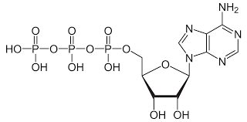
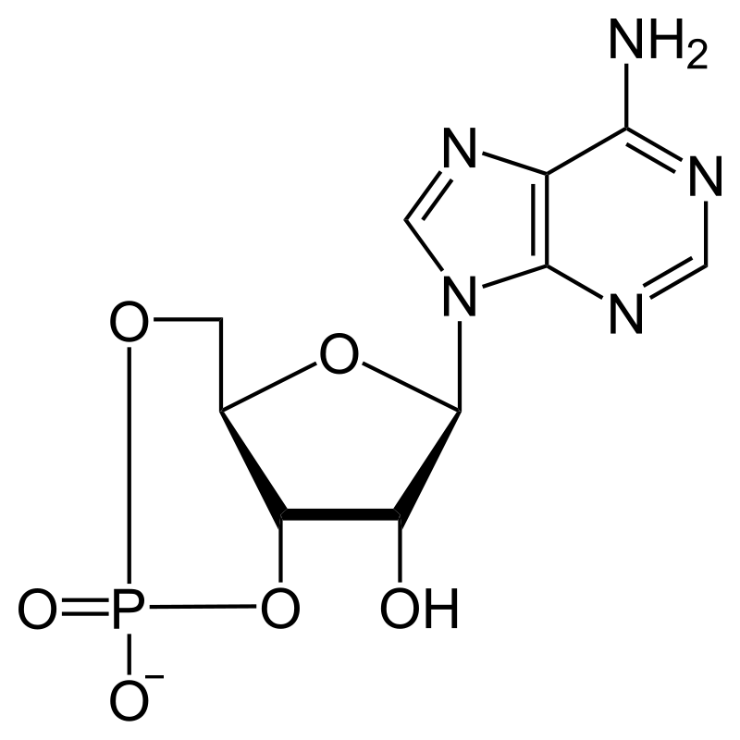
Adenylate cyclase
This molecule is called cyclic because 3’C of the pentose sugar is covalently bonded to P1.

Slide 11


GPCR and cAMP pathway
Hormone/1st messenger binds to GPCR.
The hormone‐bound receptor binds to the G‐protein and causes GDP to be replaced by GTP.
GTP‐bound G‐protein stimulate or inhibit adenylate cyclase to make more or less cyclic AMP. interacts with adenylate cyclase.
G‐protein hydrolyzes bound GTP to GDP, thereby going back to the ground state.

Slide 12
Cyclic AMP doesn't act directly on its target enzymes; for example, glycogen phosphorylase and glycogen synthase. Instead, cyclic AMP stimulates a protein kinase cascade that ultimately leads to a cellular response.
Cyclic AMP binds to protein kinase A, which then catalyzes the transfer of phosphate from ATP to a serine residue on a second enzyme, phosphorylase kinase, which itself transfers a phosphate to glycogen phosphorylase.
Active glycogen phosphorylase then catalyzes the breakdown of glycogen to glucose‐1‐phosphate. This provides energy for muscle activity.

Slide 13


Slide 14
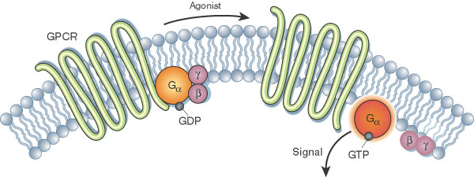

Slide 15
