Slide 1
DARWINISM AND NEO DARWINISM
DR SHARMISTHA CHAKRAVARTY
DEPT OF ZOOLOGY
BARNAGAR COLLEGE,SORBHOG
ASSAM

Slide 5
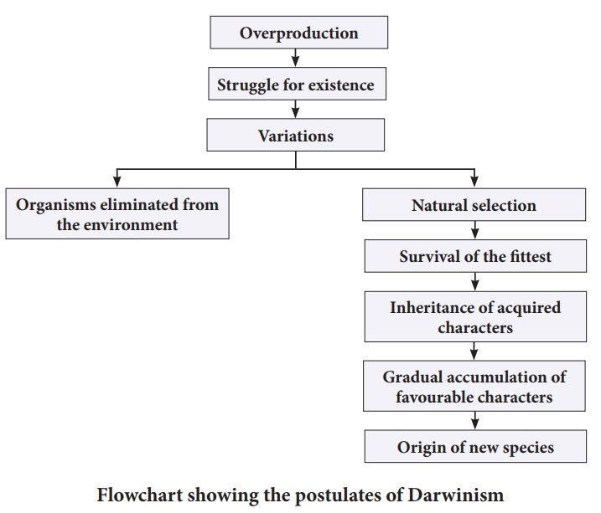

Slide 7
POSTULATES
OVER PRODUCTION OF OFFSPRING: Every living organism has got a power to reproduce fast. Thus a large number of organisms are produced every year in earth.
STRUGGLE OF EXISTENCE: As the rate of reproduction of organisms is high, they increase in a geometric ratio. There is a competition for food, space and other resources for life. Three types of struggle seen:
Intraspecific struggle
Interspecific struggle
Environmental struggle

Slide 8
VARIATIONS AND HEREDITY: Variation is defined as the difference in character between the individuals and is the inherent property of life.
Harmful variations
Useless variations
Useful variations
SURVIVAL OF THE FITTEST: The organisms provided with successful variations succeed in the struggle for existence. These organisms are the fittest for survival , those unfit to survive dies.
ORIGIN OF SPECIES : Darwin concluded that the struggle for existence leading to survival of the fittest tend the successive generations to become better adapted to their environment.

Slide 9
CRITICISM OF DARWINISM
Darwin explained the survival of the fittest not arrival of the fittest.
Darwin did not made any distinction between heritable and non heritable variations.
Origin of variations is not explained.
Overspecialization of some organs is not explained.
As per theory of natural selection, only the useful organs are selected in the struggle for existence. Then vestigial organs serve no function yet they are preserved generation after generation.
Intermediate forms are not included in the formation of new species

Slide 12
Postulates
Origin of variations: As it was the main objection of Darwinism that it could not explain the origin of variation. Variations are formed due to following processes:
Mutation
Recombination
Migration
Non random mating
Hybridization
Genetic drift
Inheritance of variations: This was explained by Germplasm theory proposed by August Weismann in 1904

Slide 13
Natural selection: It is responsible for maintaining constancy of a species, as well as changing it. It maintains constancy as long as environment remains stable but promotes formation of new species when environment changes.
Isolation: Speciation occurs due to isolation of sub groups of a population having different genotypes.

Slide 14
Experimental evidences to prove darwinism
Industrial melanism in peppered moth: industrial melanism is a phenomenon where the moths living in industrial areas develop black color to match the body to soot covered background on the bark of trees
Weldon expt with shore crabs
Antibiotic resistance in bacteria
Pesticide resistance
Survival of Galapagos finches
Decline of male peacock with less impressive tails
Malaria resistance in human

